Slide 1
From Containers to OpenShift
By : Oren Oichman
Title: Senior Solution Architect
Email : ooichman@redhat.com
IRC : two_oes/ooichman

Slide 2
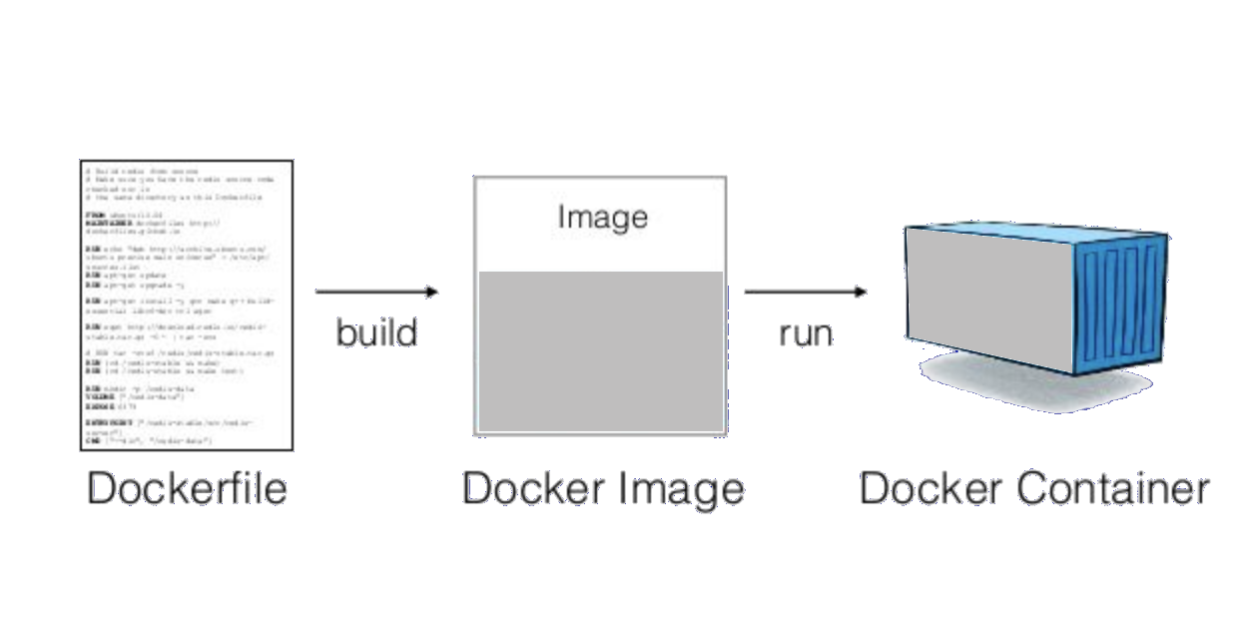
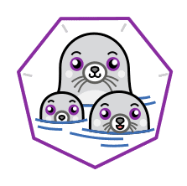

The History of Containers
What is a Container ?
Phase I
Phase II
Phase III
Phase V
Phase V

Slide 3

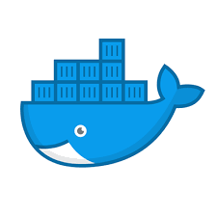


Basic Definitions
The History of Containers

Slide 4
The History of Containers
What is Podman?
Phase I
Phase II
Phase III
Podman was released with Red Hat Enterprise Linux 7.6 and 8.0 as the next generation of Linux container tools, is designed to allow faster experimentation and development of features.

Slide 5
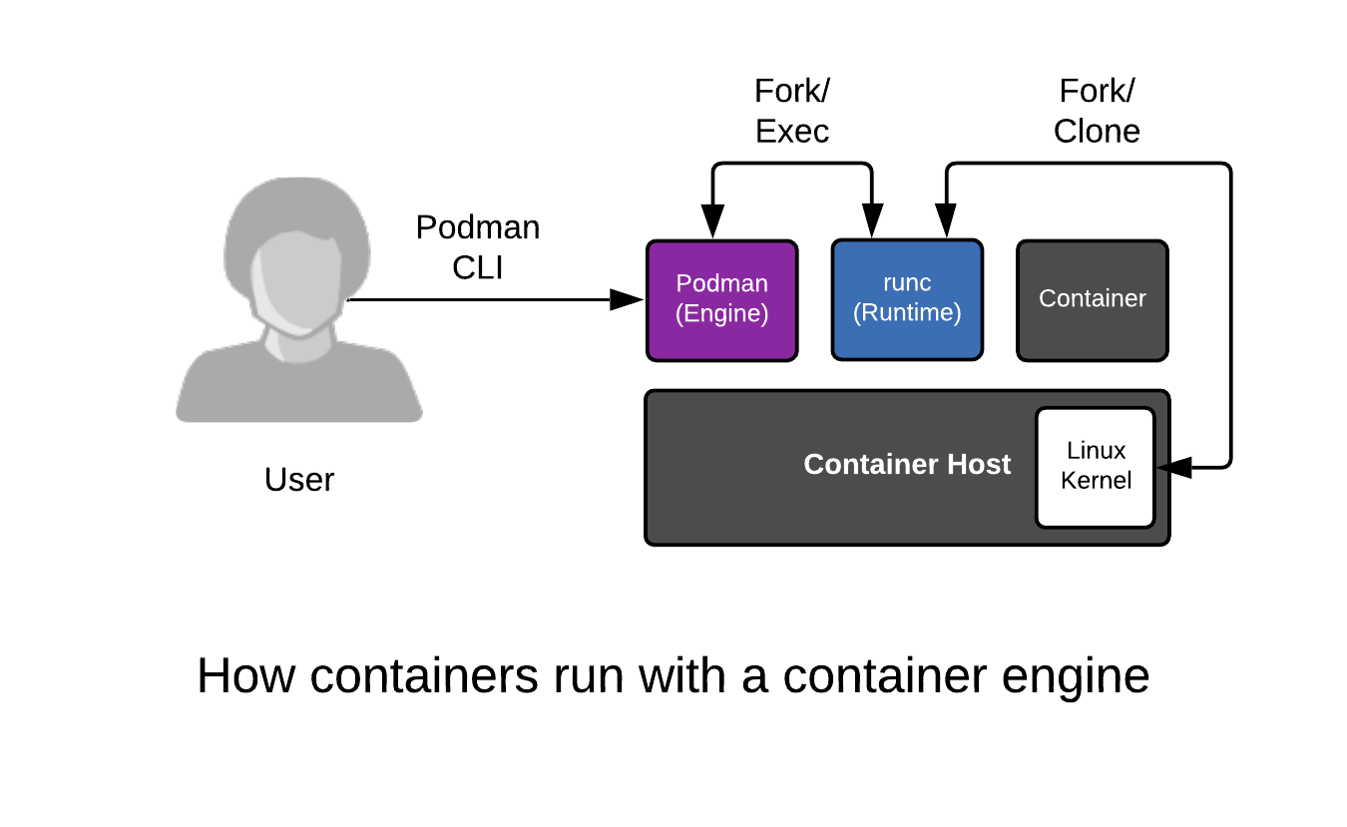
The History of Containers
How does Podman work?
Phase I
Phase II
Phase III

Slide 6

The History of Containers
What is buildah?
Buildah - A tool that facilitates building Open Container Initiative (OCI) container images
Phase I
Phase II
Phase III

Slide 7
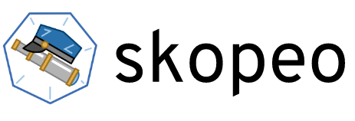
The History of Containers
What is skopeo?
skopeo is a command line utility that performs various operations on container images and image repositories.
skopeo does not require the user to be running as root to do most of its operations.
skopeo does not require a daemon to be running to perform its operations.
skopeo can work with OCI images as well as the original Docker v2 images.
Phase I
Phase II
Phase III

Slide 8

The History of Containers
Phase I
Phase II
Phase III
Phase V
Phase V
According to industry analyst firm Gartner, “By 2025, more than 85% of global organizations will be running containerized applications in production, which is a significant increase from fewer than 35% in 2019.”

Slide 9



Is podman enough ?
Optional section marker or title
Running multiple pods at mount
Can a Platform Engineer maintain a large amount of running pods using a multiple nodes with podman alone ?
35%
85%
2019
2025
global organizations will be running containerized applications by 2019
global organizations will be running containerized applications by 2025
Source:
Insert source data here
Insert source data here
Insert source data here

Slide 10
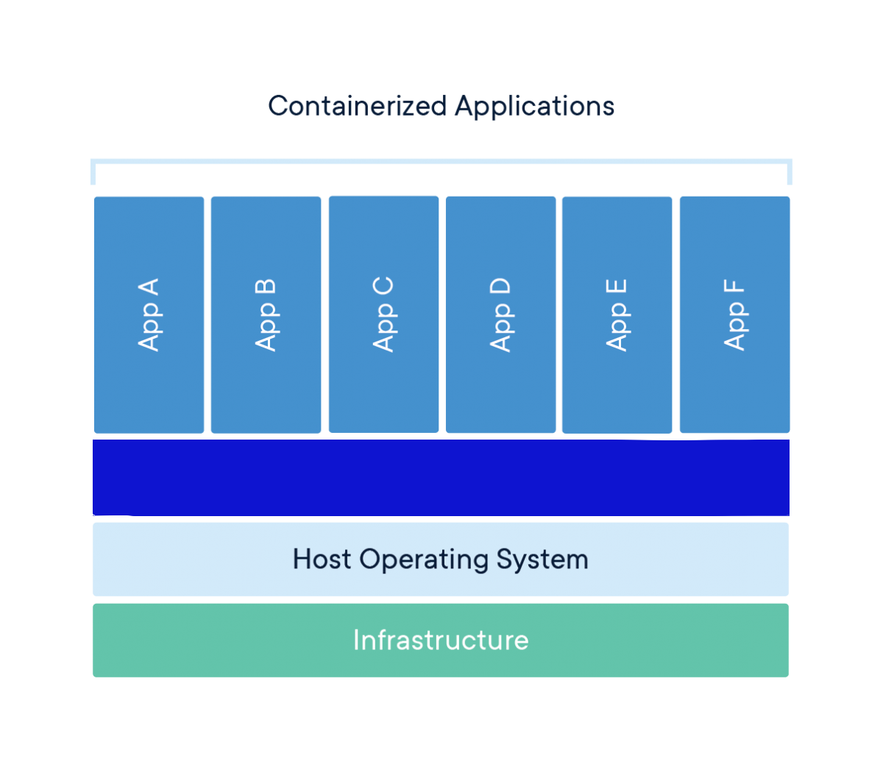
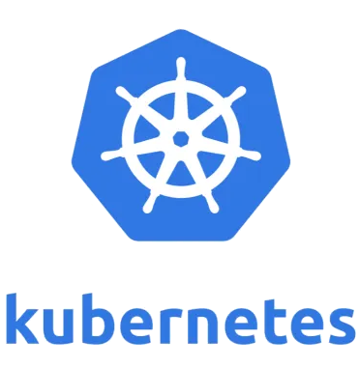

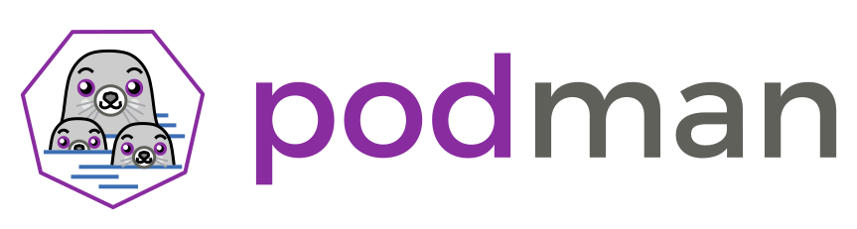
The History of Containers
We need a Transition
Phase I
Phase II
Phase III
Phase V
Phase V

Slide 11
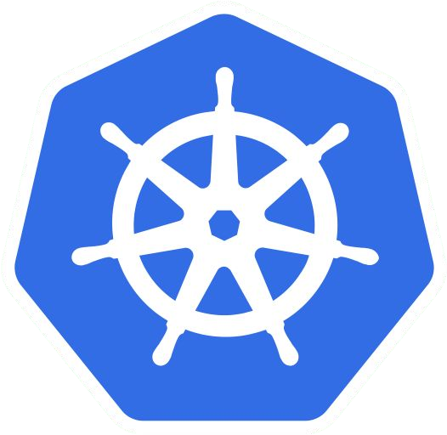
Red Hat® OpenShift® is a comprehensive enterprise-grade application platform
built for containers with Kubernetes at its core.

Slide 12
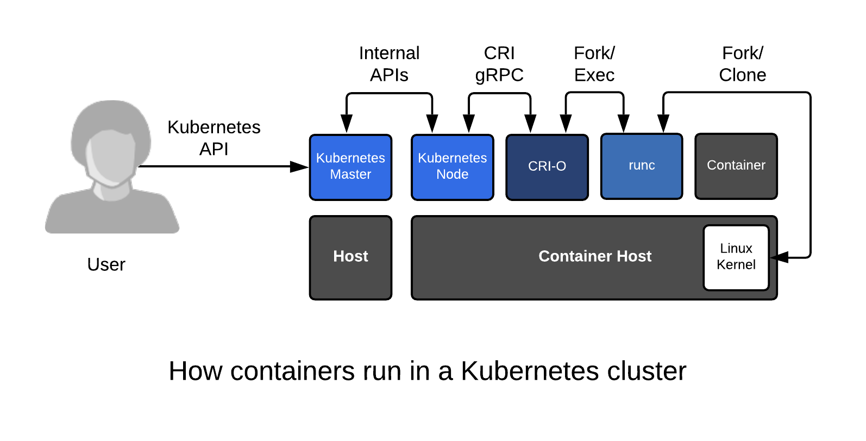
How Kubernetes Works?

Slide 13

OpenShift Components
DEVELOPER SOLUTIONS
Developer Studio
CDK
Tools
CONTAINER
CONTAINER
CONTAINER
CONTAINER
CONTAINER
MANAGEMENT SOLUTIONS
CloudForms
Satellite
Ansible
SELF-SERVICE
SERVICE CATALOG
(LANGUAGE RUNTIMES, MIDDLEWARE, DATABASES, …)
BUILD AUTOMATION
DEPLOYMENT AUTOMATION
APPLICATION LIFECYCLE MANAGEMENT
(CI / CD)
CONTAINER ORCHESTRATION & CLUSTER MANAGEMENT
(KUBERNETES)
NETWORKING
STORAGE
REGISTRY
LOGS & METRICS
SECURITY
INFRASTRUCTURE AUTOMATION & COCKPIT
RED HAT ENTERPRISE LINUX
CONTAINER RUNTIME & PACKAGING
(CRIO)

Slide 14
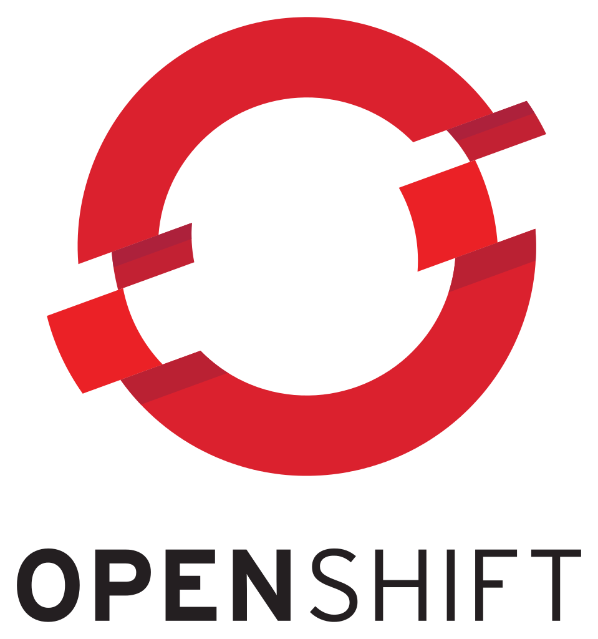
OpenShift vs. Kubernetes: The Seven Most Critical Differences
Product vs. Project
Security
Web-UI
Deployment Approach
CI/CD
Integrated Image Registry
Updates

Slide 15


The History of Containers
Begin Exercise 2
Source:
Insert source data here
Insert source data here
Insert source data here

